Slide 1


Cook Book: Your Virtual Kitchen Assistant
This presentation introduces the innovative concept of a virtual kitchen assistant designed to simplify your cooking experience. With features like personalized recipe suggestions based on dietary preferences, step-by-step cooking guidance, and tips to enhance cooking skills, this tool promises to revolutionize meal preparation. Discover how it can save you time, reduce meal stress, and cater to your unique nutritional needs, making cooking enjoyable and efficient.

Slide 2





What is a Virtual Kitchen Assistant?
1
Digital Cooking Helper
A digital tool designed to assist users with cooking tasks.
2
Voice-Activated Guidance
Integrates with smart devices for hands-free cooking.
3
Personalized Recipe Suggestions
Adapts to individual tastes and dietary needs.

Slide 3




Key Features of Virtual Kitchen Assistants
Recipe Databases
Meal Planning Tools
A comprehensive collection of recipes from various cuisines allows users to explore and try new dishes.
Virtual assistants help plan meals based on user preferences and available ingredients.
1
2
Nutritional Information
Step-by-Step Guidance
Access to nutritional data for recipes for informed food intake decisions.
4
3
Provides detailed cooking instructions, breaking down recipes into manageable steps.

Slide 4




Benefits of Using a Virtual Kitchen Assistant
1
2
3
4
Time-Saving
Skill Development
Increased Variety
Waste Reduction
Automates meal planning, allowing users to enjoy cooking more.
Provides cooking tips that boost culinary skills and confidence.
Encourages experimentation with diverse recipes and cuisines.
Minimizes food waste through effective meal planning.

Slide 5
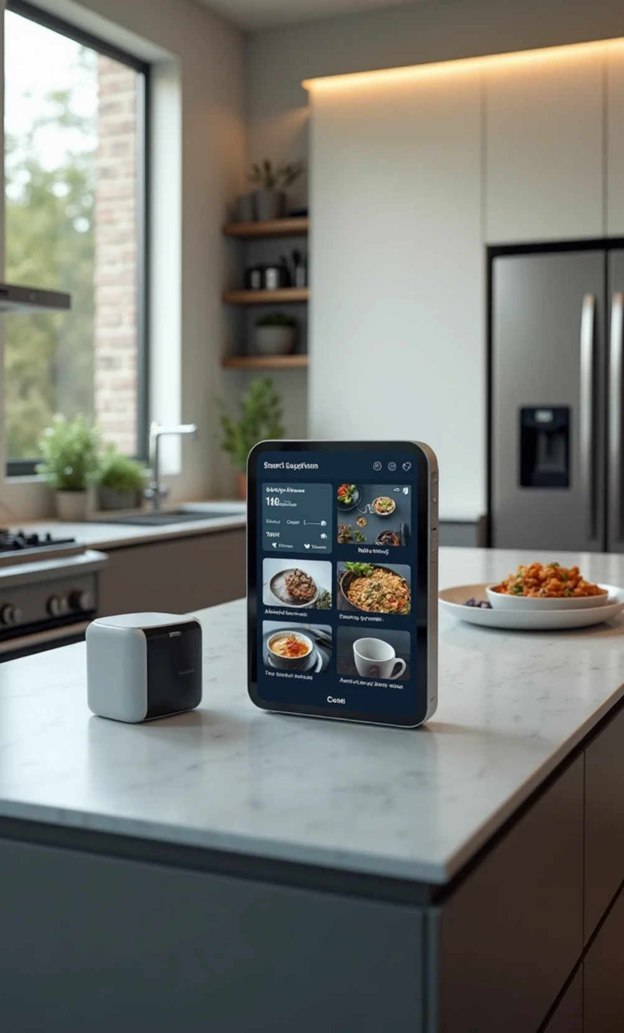




Future of Virtual Kitchen Assistants
1
2
Smart Technology Integration
AI Personalization
AI advancements for better understanding of user habits and preferences.
Enhanced integration with smart home devices for seamless cooking.
3
4
Community Features
Dietary Inclusion
User communities for sharing recipes and tips enhancing engagement.
Expanding options for vegan, gluten-free, and specialized diets.

Slide 6
Revolutionizing Cooking with Virtual Kitchen Assistants
A virtual kitchen assistant serves as a modern solution for anyone looking to enhance their cooking experience. By simplifying meal planning, providing expert guidance, and catering to individual preferences, it transforms the way we approach cooking. Embracing this technology not only makes cooking more enjoyable and efficient but also promotes healthier eating habits and reduces food waste over time. As technology continues to advance, the potential for virtual kitchen assistants to revolutionize home cooking remains immense, paving the way for creative culinary exploration.
Modern Solution
Enhances cooking experience through meal planning and guidance.
Healthier Eating
Promotes healthy habits and reduces food waste.
Creative Exploration
Paves the way for innovative cooking with technology.

